Slide 1

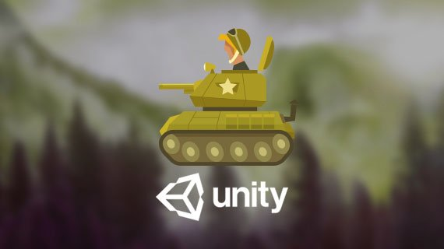

2D TANK GAME USING UNITY ENGINE
GROUP MEMBERS:
Name | Roll No | Batch
Anushka Karamchandani | 16010120191 | C3
Rudar Mahajan | 16010120205 | C3
Suhil Mir | 16010120206 | C3

Slide 2

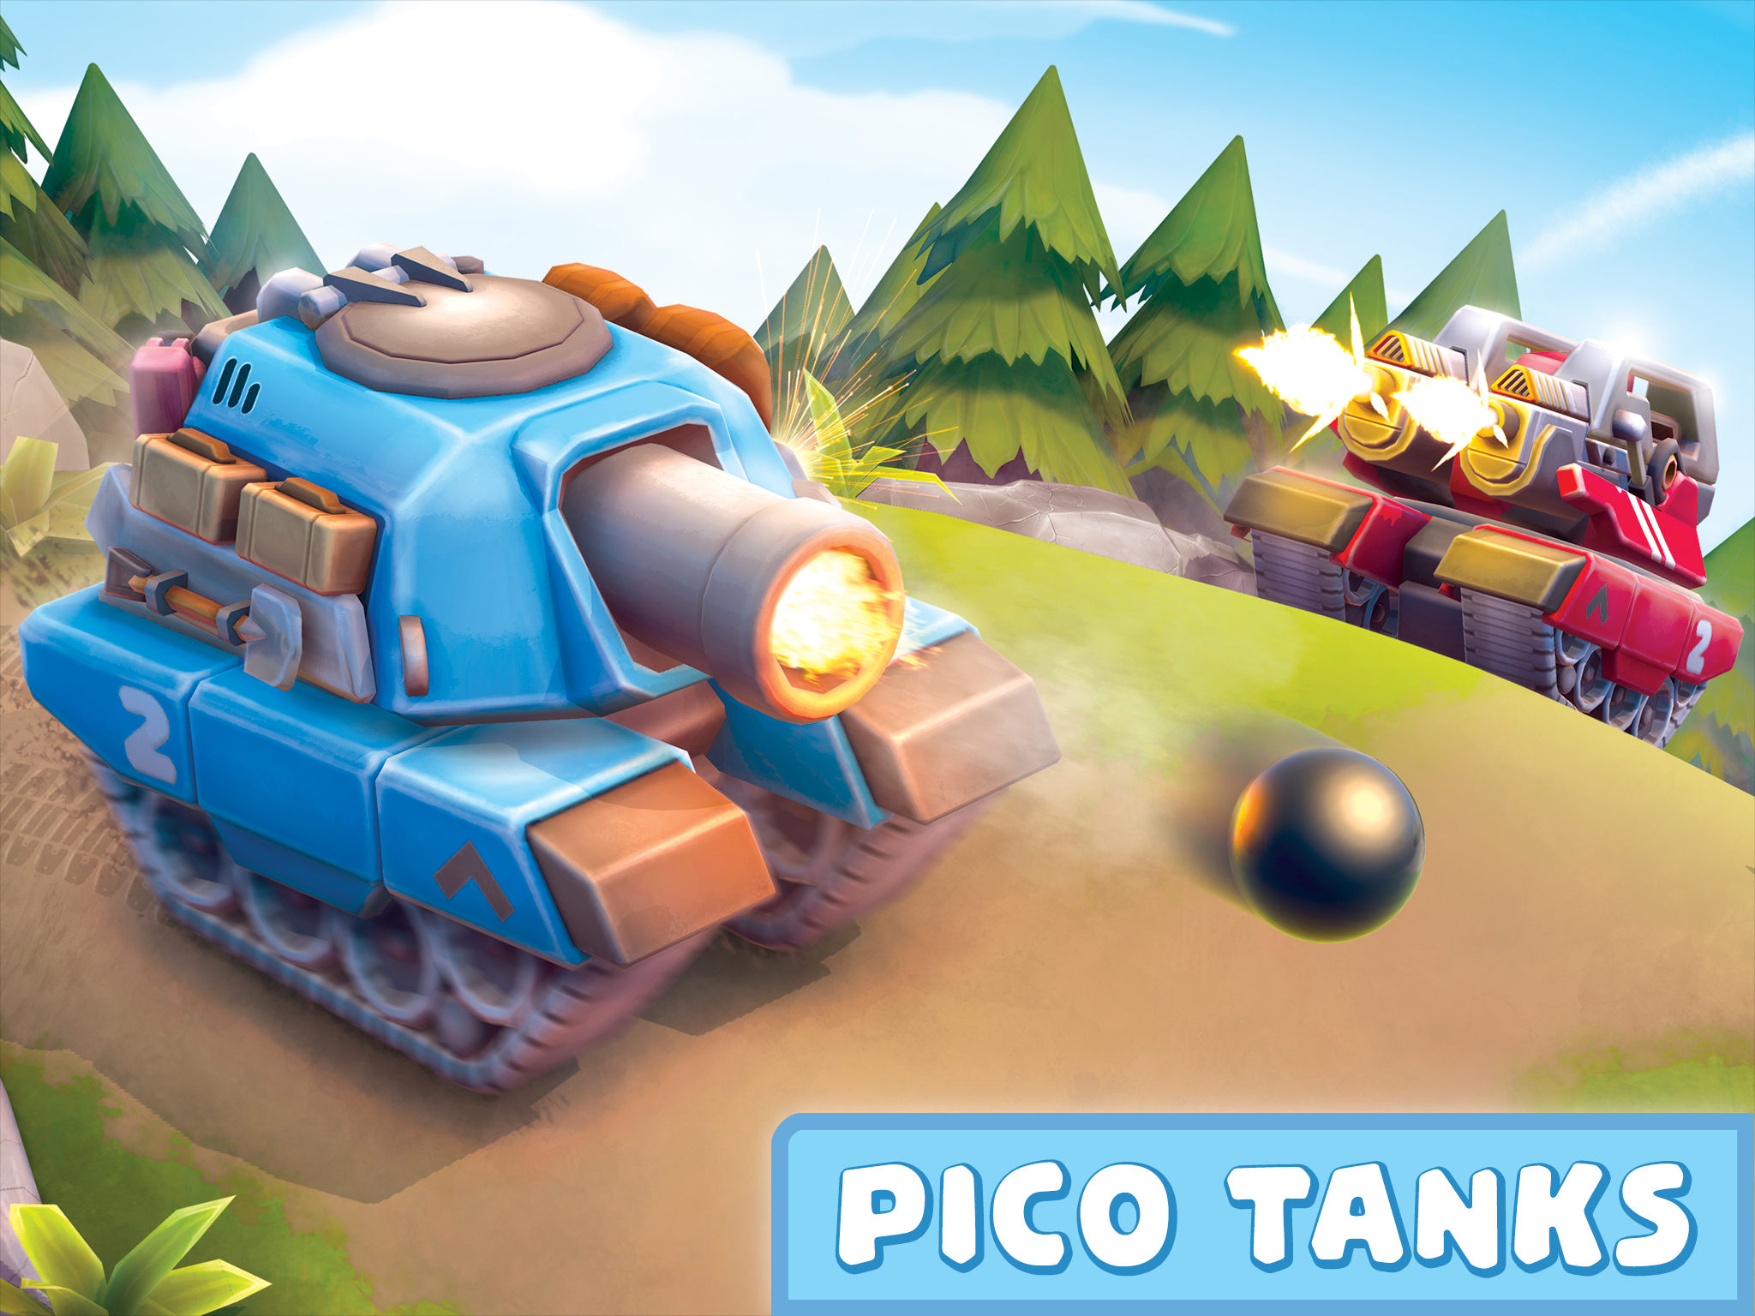
PROBLEM STATEMENT
In this project we’ll be developing a 2d top-down tank game named ‘Tanks!!!’ with the help of game development engine.
The game will contain several levels with increasing level of difficulty.
The player will be able to control a tank, i.e. its movement and turret movement.
The player can shoot bombs from the turret at other AI tanks and destroy them, and the player also needs to defend from the bombs of AI tanks, if the player fails to defend the tank, the health of the tank deteriotes.
The level will be passed when the player destroys all the AI tanks on the map without getting destroyed.

Slide 3
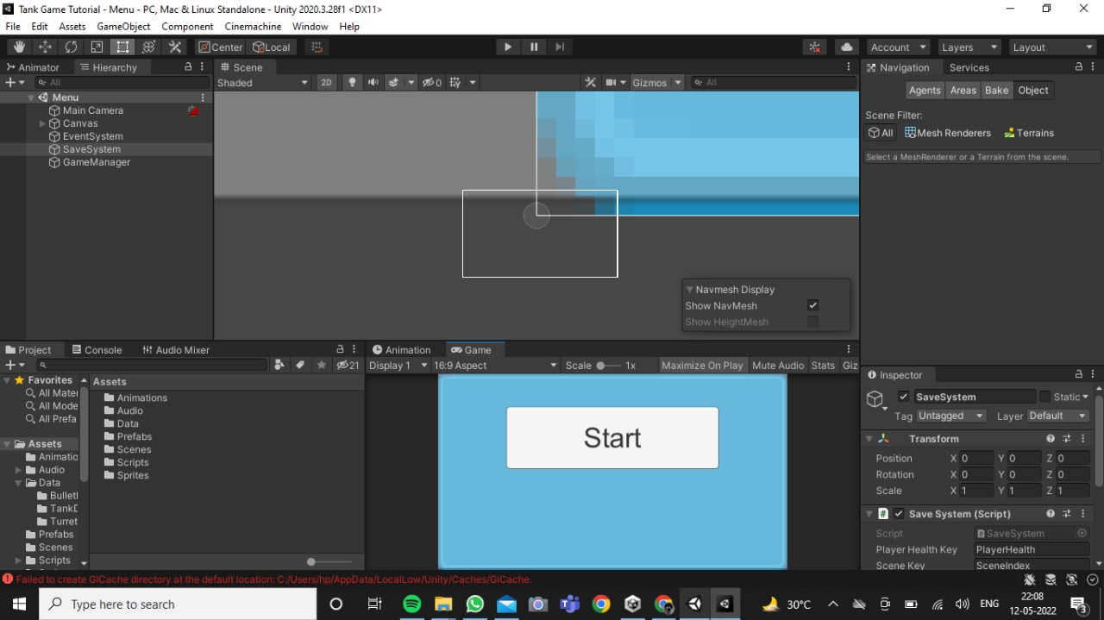

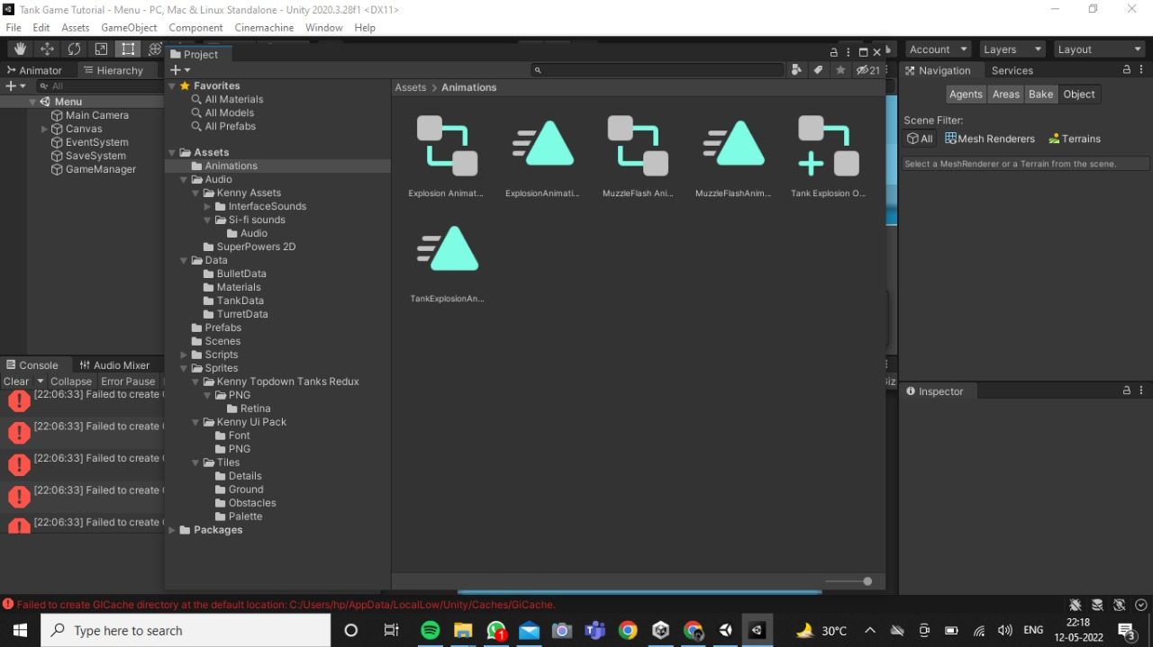

RESOURCES
UNITY SOFTWARE
ANIMATIONS BY UNITY
SOFTWARE

Slide 4
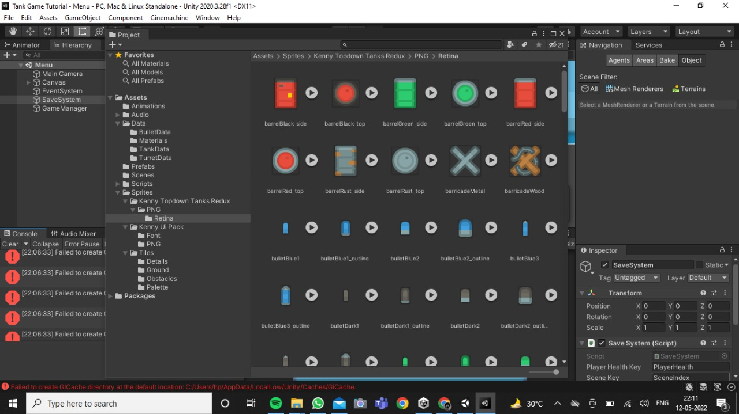
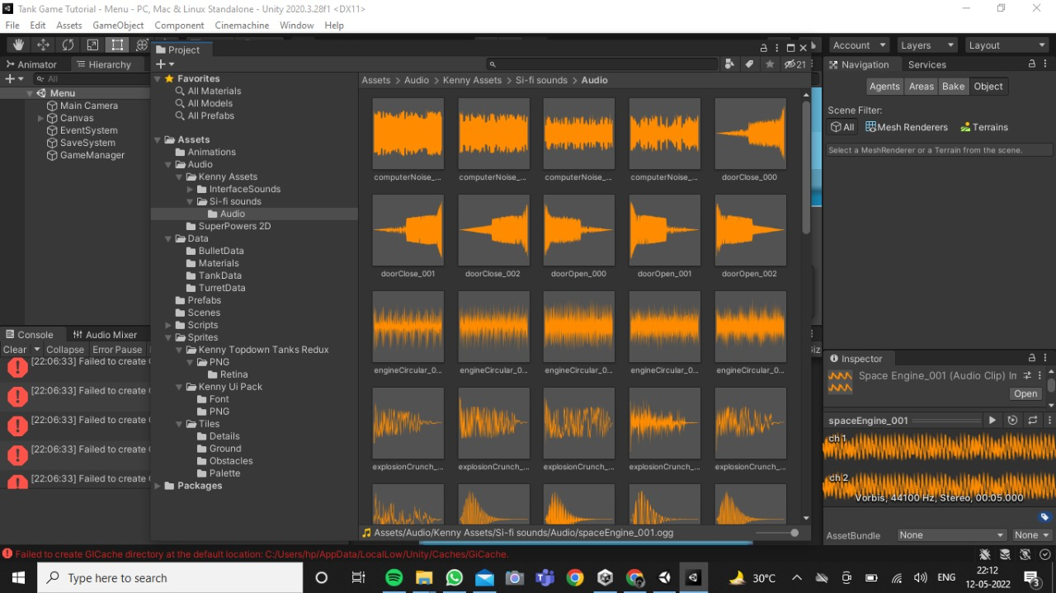

SPRITES BY KENNY
AUDIO FILES FROM GITHUB

Slide 5
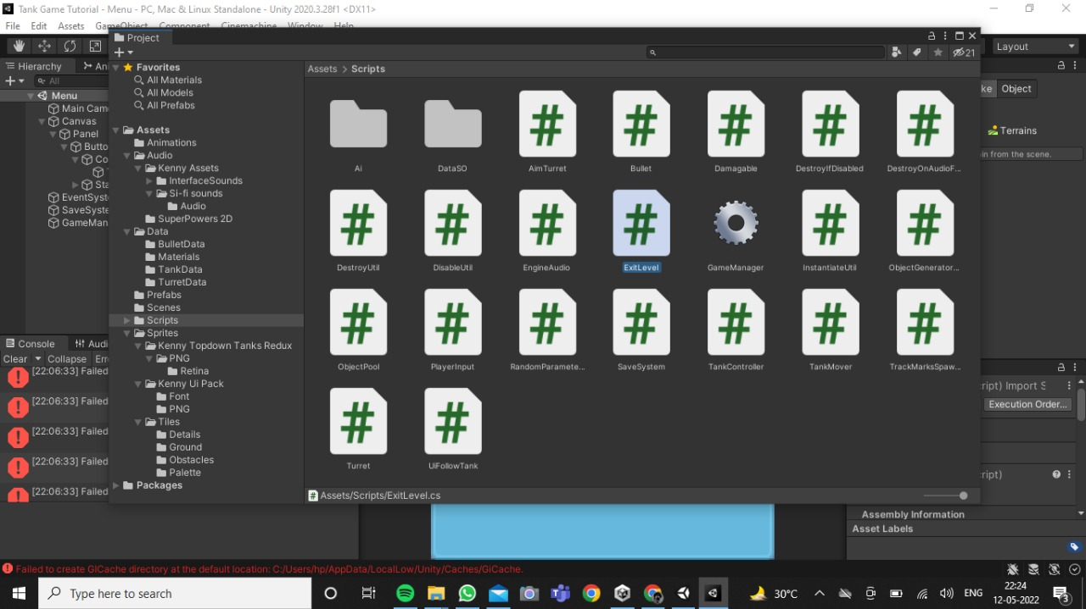
SCRIPTS USED

Slide 6
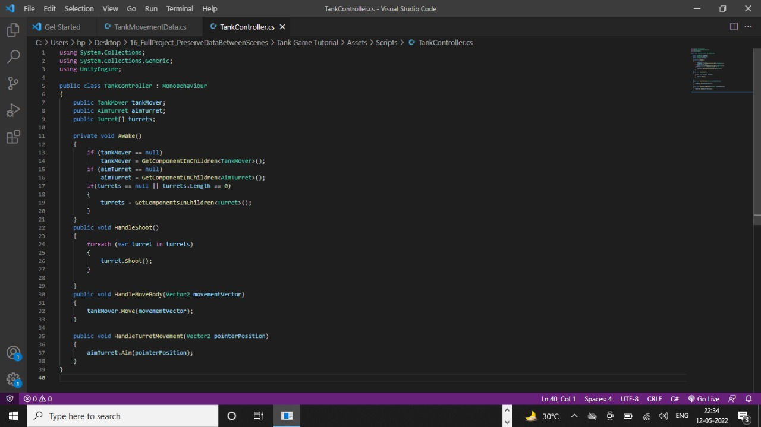

Slide 7
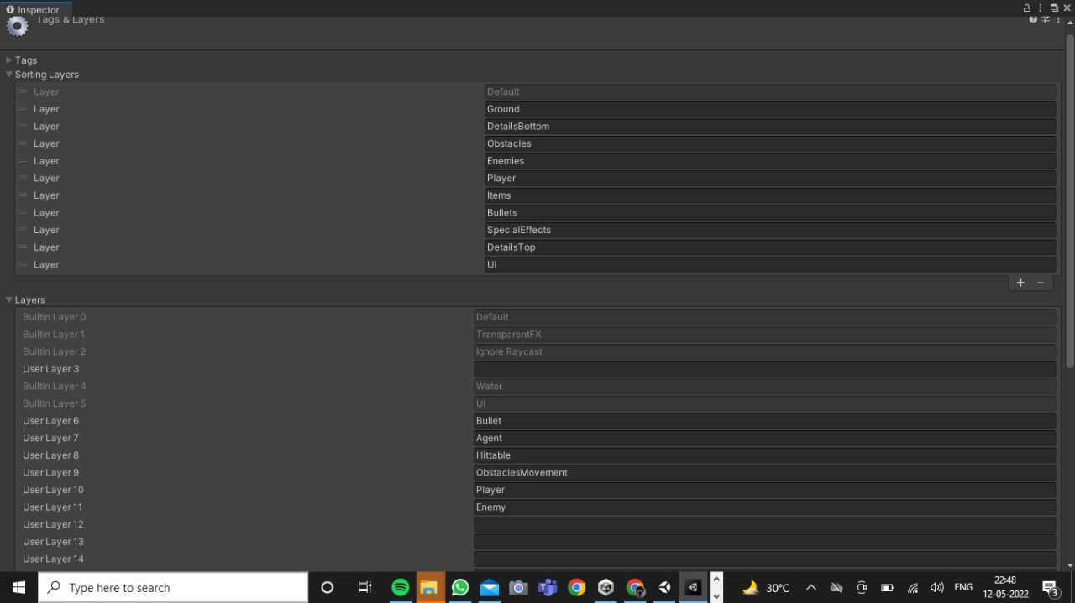
SORTING LAYERS

Slide 8
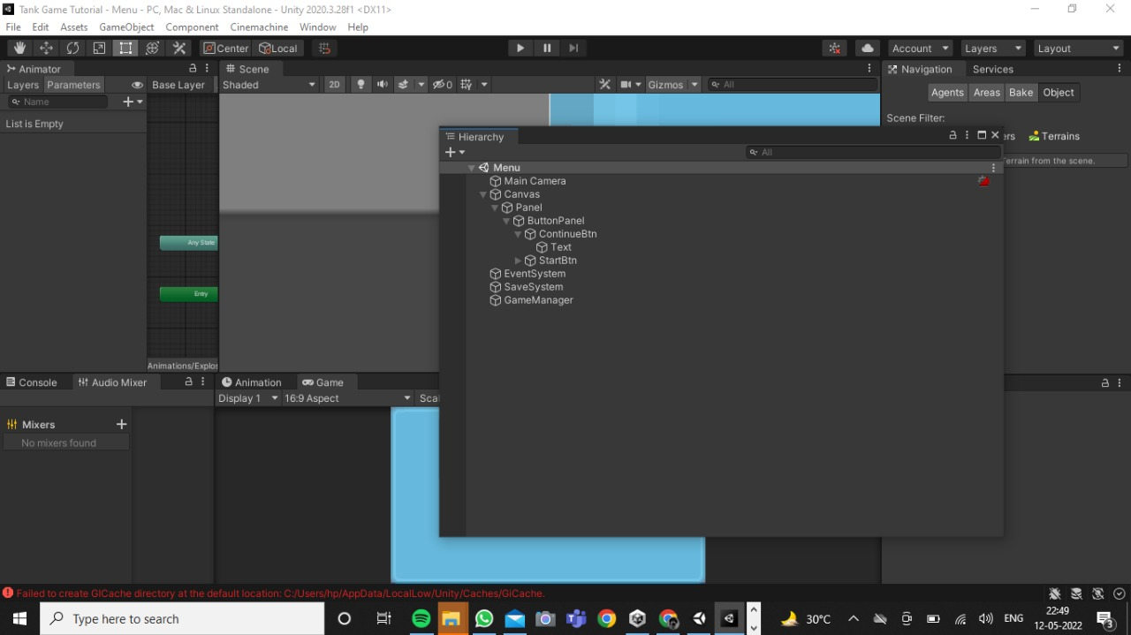
HIERARCHY

Slide 9
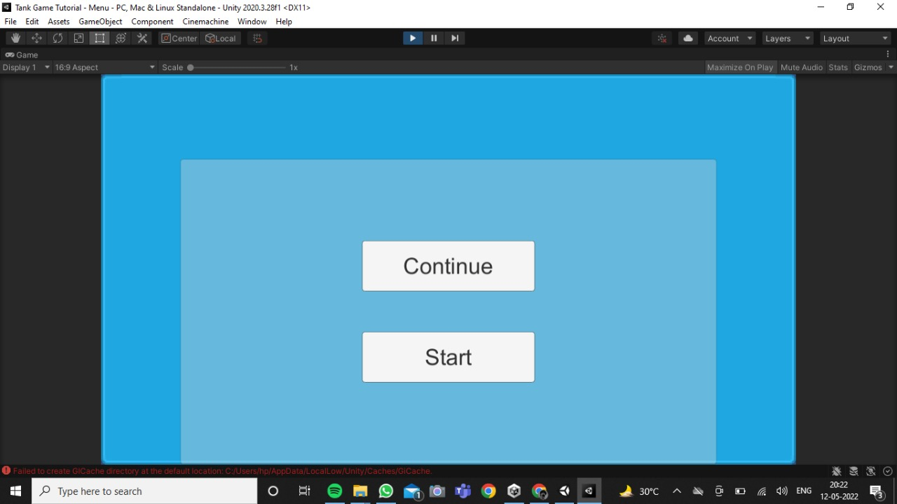
UI OF THE GAME

Slide 10
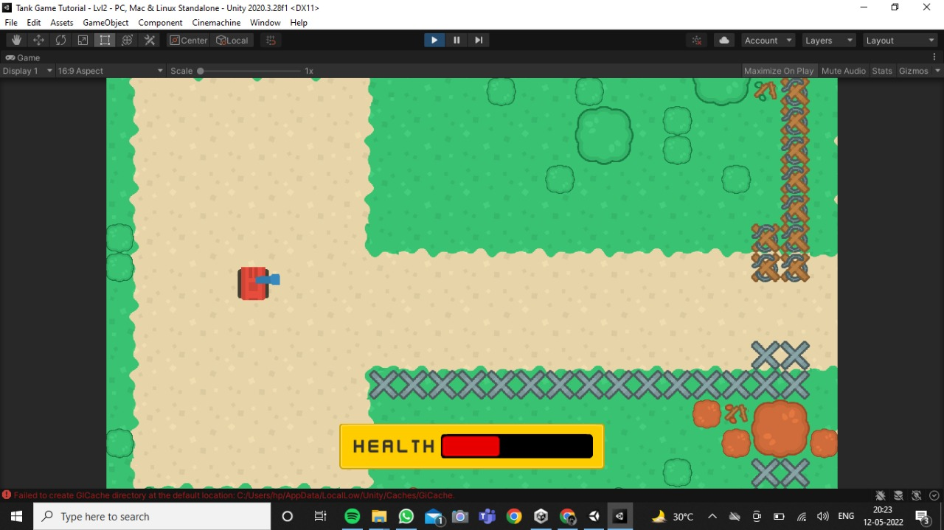
TANK,OBSTACLES,HEALTHBAR,OTHER DETAILS

Slide 11
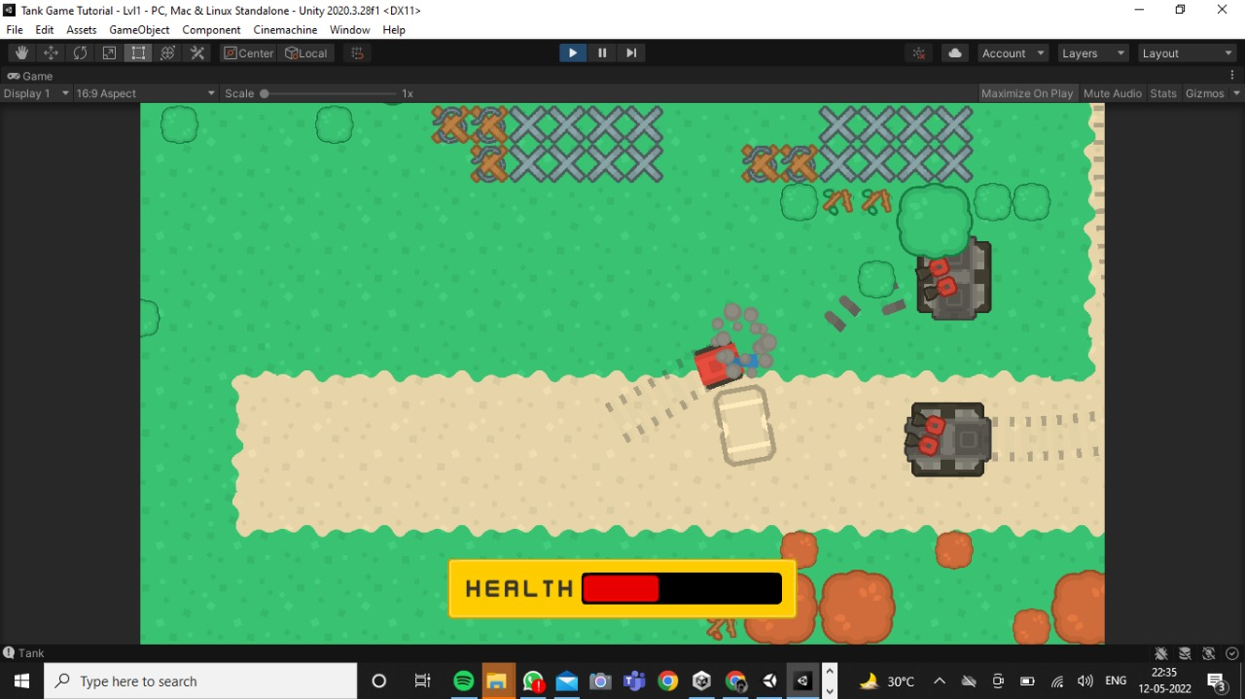
AI OF THE GAME

Slide 12
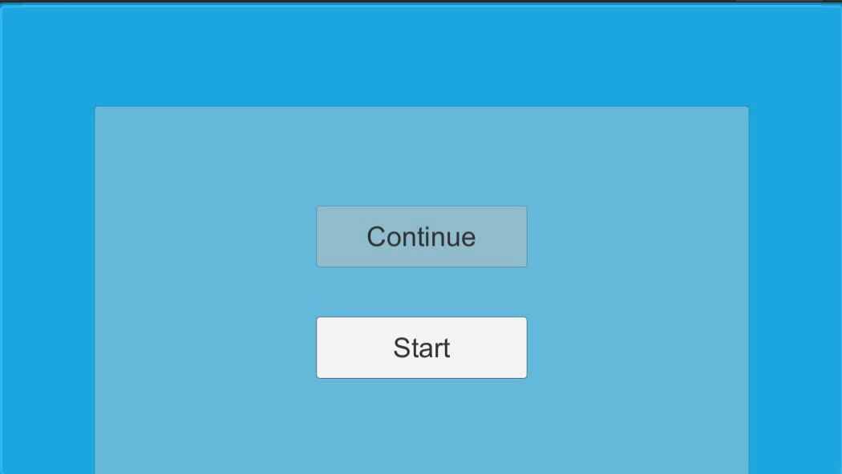
DEMONSTRATION

Slide 13

FUTURE SCOPE
Maintain the system and fix the bugs and upgrade up to 3 months after publishing on steam.
More levels can be added, so that the game becomes more interesting.
The game can be updated such that it can be played in online mode, so that user and his/her friends can play together sitting at their own homes.
The game can be made multiplayer, so that minimum two players can play the same game together.
Option for changing the game theme, and tank design can be given.

Slide 14


